Slide 1
Club Starter Fund
Guide for Clubs

Slide 2
Application Guide
About the fund
Criteria
Application Information
Reviewing Applications
Terms and Conditions
NDO Contacts

Slide 3
1. About the fund
The fund is designed to support new clubs and new sections of clubs. The fund is a partnership between Netball South West (NSW) and County Netball Associations (CNA) to support more people to get involved in clubs and ultimately become members and experience the benefits of playing netball within our region's local clubs and leagues. NETBALLHer is at the heart of everything NSW and EN do, and we would like to see this reflected in the fund.
The funding is capped at £400 per club with the amount contributed by the CAN and NSW to be determined by your County Netball Association. NSW will match whatever the CAN is contributing to a maximum of £200
Each CAN will work with NSW to select one club to work with during the 25/26 season.
The fund can be used for costs associated with starting a new club or section.
Including:
Court Hire Costs.
Equipment (bibs, balls, cones etc).
England Netball courses for coaches or umpires where counties do not provide this separately.
Other training for coaches and volunteers such as first aid and safeguarding., NETBALLHer CPD, Neurodiversity Training.
You cannot use the funding for the following:
EN Membership fees
Coach or umpire payments
Playing or training kit (dresses, hoodies etc).

Slide 4
2. Criteria
Applications must be submitted to NSW via the application form within the application window.
Potential clubs should reach out to their local NDO to determine their ability to apply before submitting an application.
Clubs can either be completely new Adult/Back to Netball clubs, Junior Clubs or be an additional junior section to existing clubs. If they are an addition to an existing club, they must be adding an age group to the current delivery. - We would consider a new adult team/section if the ladies had not previously been members of EN and NSW
This grant cannot be used to increase capacity in the current club with ladies/girls who are or have recently been members of EN and NSW.
Any club/section applying for the fund must be or be working towards being EN and NSW members.
Any club/section applying for the fund must show how they plan on incorporating NETBALLHer into their 'everyday' practice.
Any club/section or group applying for the fund must show their dedication to working with their CNA NSW to document how their funding is going towards enhancing people's netball experience, to retain CAN members and build meaningful case studies.
Any club/section will be expected to set the standards of good practice across the South West and showcase their stories to inspire others across the region. This could include regular contact with their local NDO, CNA and NSW to show progress.
Clubs or sections applying must be new for 2025-26 and not be already existing.
2025-26 funding application window is open from:
1st October to 31st December.

Slide 5
3. Application Information
You will need to prepare the following information to complete the online application form (link in next section).
Club details- Name, contact details, address, website or social media.
Information about your plans, what funding you require and for what purpose. We highly recommend this includes any plans to embed NETBALLHer into your sessions and club culture, this could include the upskilling of your coaches and club members.
Details of any other organisations supporting you.
How many people will be involved in your club, players, volunteers, coaches and officials at the start and end of the project.
How you intend to sustain your club in the future
How you intend to document your good practice to ensure you can showcase how the fund has supported your club/section or group.
Contact name, number and email address who will be the link between NSW and your club. We would like to keep in contact throughout the 25/26 season with successful applicants.
It may be a good idea to write the information in a word document to copy across to the form and for your records. You will be able to save a copy of your completed form. You may wish to run your application past your local NDO before submitting.

Slide 6
4. Reviewing Applications
Applications must be made using the following form: https://forms.office.com/e/RvLANZcDkm during the application window. Any applications made outside of this window will not be considered.
County Chairs will take all applications to their CNA committee and make a decision around which club/section or group they would like to support. Each county will only work with 1 club/section.
The CNA/Local NDO will confirm the outcome with the one successful club/section and NSW via the successful application form and arrange payment of the agreed amount from both CNA and NSW.
Once the application window closes, all submitted applications will be sent to the respective NDO and County Chair.
Please note:
After the application window closes response times may vary depending on your CNA meeting schedules. Please contact your NDO for more information or to follow up your application.

Slide 7
5. Terms and Conditions
Funding is awarded at the discretion of the CNA & NSW – the maximum award amount is £400, however this is at the CNA discretion, and they may choose the amount of funding they deem appropriate.
Grants must only be paid into club/organisation bank accounts.
The awarding CNA/NSW can request proof of spending by the club awarded funding, clubs should provide this on request.
Clubs are required to provide ongoing updates to NSW throughout the 25/26 Season, alongside a case study at the end of the season. Successful clubs will be provided with full guidance from NSW.
.
6. NDO Contacts
Avon – emily.lemoir@englandnetball.co.uk
Cornwall – Fern.Noott@englandnetball.co.uk
Devon East & West – Johanna.Templeman@englandnetball.co.uk
Dorset – Sarah.Clark@englandnetball.co.uk
Gloucestershire- Alice.Skuse@englandnetball.co.uk
Somerset – Johanna.Templeman@englandnetball.co.uk
Wiltshire – Anna.Young@englandnetball.co.uk

Slide 8
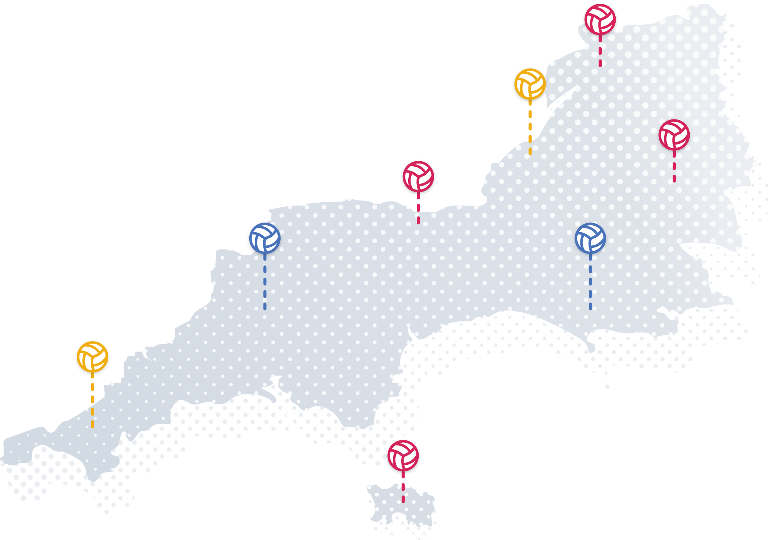
If you have any questions, please contact emily.lemoir@netballsouthwest.co.uk

